Slide 1


Holiday Programming
Wednesday, October 7th

Slide 2

Bedford
How are modifying these events to make them socially distant and/or compliant with CDC/DOH requirements?
Halloween/Fall Events
December Holiday Events
What have you done in the past?
  Craft/pumpkin carving night
What are you doing now?
  Trick or Treat event in park
What have you done in the past?
  Gingerbread house decorating
  Breakfast with Frosty
  Letters to Santa
  Senior Holiday Luncheon
What are you doing now?
  Gingerbread house decorating
  Letters to Santa
Outside events
Registration required

Slide 3
Eastchester
How are modifying these events to make them socially distant and/or compliant with CDC/DOH requirements?
Halloween/Fall Events
December Holiday Events
What have you done in the past?
  Rag-a-muffin parade
  Trunk or Treat
What are you doing now?
  Virtual Pumpkin Design via Instagram
  Virtual Costume Contest via Instagram
  Drive-In Movies
What have you done in the past?
  Santa Stop
  Gingerbread House Design
  Holiday Tree Lighting
  Hanukkah Gelt Drop
What are you doing now?
  Drive-In Holiday Movie
Santa will be inside inflatable snow globe for safe picture taking

Slide 4
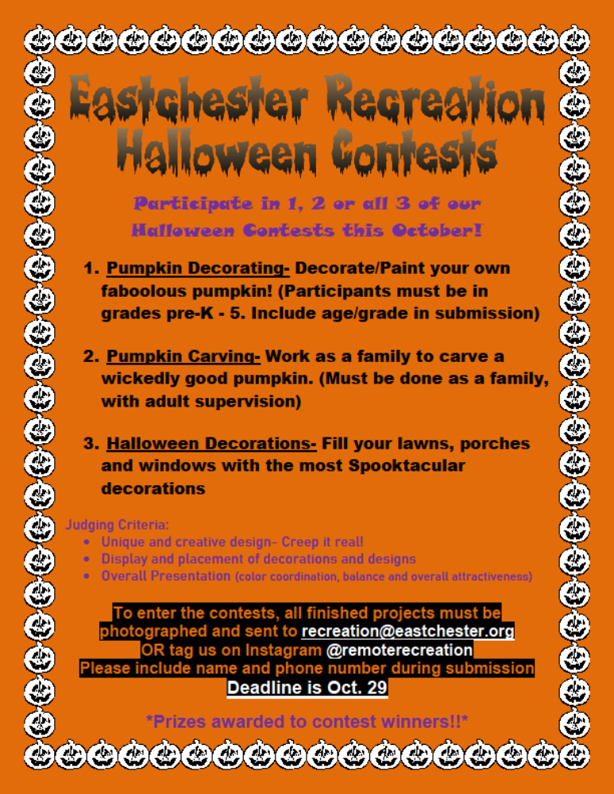

Slide 5
Greenwich
How are modifying these events to make them socially distant and/or compliant with CDC/DOH requirements?
Halloween/Fall Events
December Holiday Events
What have you done in the past?
  Halloween Party
What are you planning now?
  Pumpkin Decorating Contest
What have you done in the past?
  TBA
What are you doing now?
  TBA
TBA

Slide 6
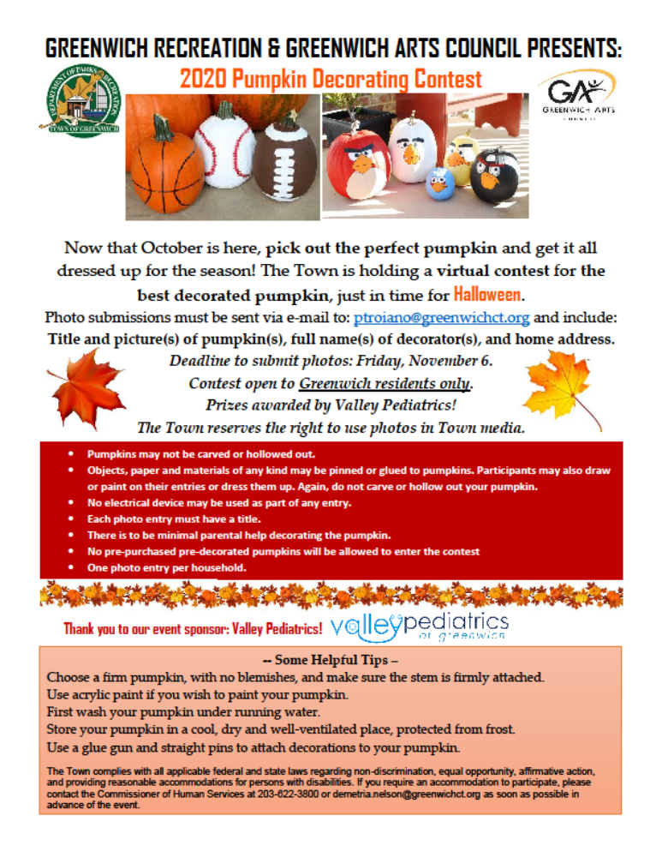

Slide 7
Lewisboro
How are modifying these events to make them socially distant and/or compliant with CDC/DOH requirements?
Halloween/Fall Events
December Holiday Events
What have you done in the past?
  Fall Fun Fest
What are you planning now?
  Thru Trunk or Treat
  Drive-In Movie
  Cookie Decorating (Outside)
What have you done in the past?
  Santa Breakfast
  Santa Letters
  Holiday Babysitting for Shoppers and Wrappers
What are you doing now?
  Santa Letters
  Santa Parade
Holding events outdoors
Limited numbers of attendees
Trying to be creative as can be!

Slide 8
New Castle
How are modifying these events to make them socially distant and/or compliant with CDC/DOH requirements?
Halloween/Fall Events
December Holiday Events
What have you done in the past?
  Ragamuffin Parade
  Kid’s movie night (Hocus Pocus)
  Rocky Horror Picture Show viewing
  Senior Thanksgiving Luncheon
  Parent’s Night Out
What are you doing now?
  Scarecrow Building event
  Virtual Halloween parade
  Drive-in movie
What have you done in the past?
  Letters to Santa
What are you doing now?
  Letters to Santa
Virtual parade with picture submissions
Outdoor activities
Limited enrollment
Take-home kits

Slide 9
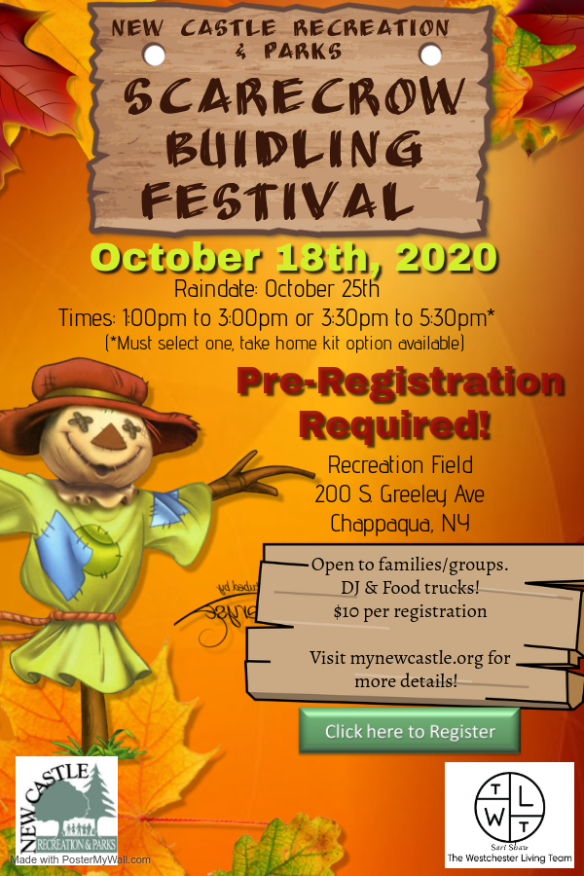

Slide 10
ramapo
How are modifying these events to make them socially distant and/or compliant with CDC/DOH requirements?
Halloween/Fall Events
December Holiday Events
What have you done in the past?
  Halloween Event & Pumpkin Patch
  Trunk or Treat
  Movie Screening
What are you doing now?
  Halloween Event outside with no inflatables
  Pumpkin decorations at home
What have you done in the past?
  Pizza with Santa
What are you doing now?
  Pizza with Santa with no inflatables, two seatings, photos with masks
No Inflatables
Outside events
Pumpkin decorating at home
Social Distancing/Masks
Multiple seatings

Slide 11
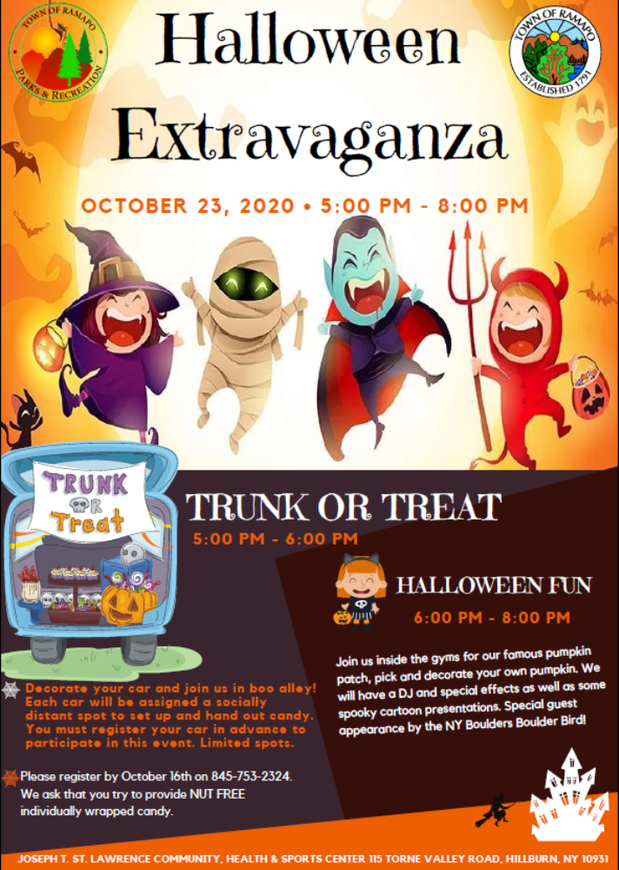

Slide 12
Rye
How are modifying these events to make them socially distant and/or compliant with CDC/DOH requirements?
Halloween/Fall Events
December Holiday Events
What have you done in the past?
  Halloween Window Painting
  Turkey Trot
What are you doing now?
  Halloween Crawl
  Drive-In Movie
What have you done in the past?
  Santa Calling
  Breakfast with Santa
  Holiday Bonfire & Sing-a-long
  Dear Santa Letters
  Family Fun Days
  Indoor camps
  Shows
  Ice Cream Social
What are you doing now?
  Gingerbread house decorating
  Letters to Santa
Rotating groups
Limited registration
Calls will be made from home instead of at Rec.

Slide 13
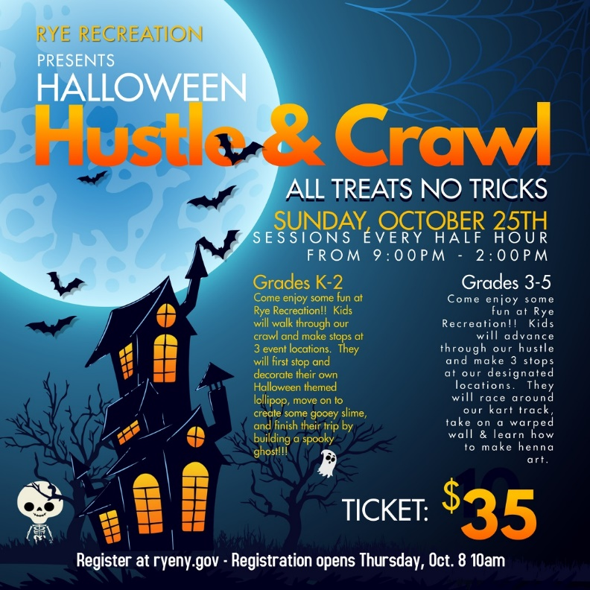

Slide 14
Scarsdale
How are modifying these events to make them socially distant and/or compliant with CDC/DOH requirements?
Halloween/Fall Events
December Holiday Events
What have you done in the past?
  Fall Festival/Scarecrow Making Contest
  Halloween Window Painting
  Halloween Costume Parade
What are you doing now?
  Fall Festival/Scarecrow Making Contest
  Halloween Window Painting
  Possible Virtual Costume Contest
What have you done in the past?
  Breakfast with Santa
  Holiday Tree Lighting
What are you doing now?
  Holiday Tree Lighting
Pre-registration required
Stations
Social Distancing/Sanitizing
Multiple Sessions

Slide 15
Sleepy Hollow
How are modifying these events to make them socially distant and/or compliant with CDC/DOH requirements?
Halloween/Fall Events
December Holiday Events
What have you done in the past?
  Two-day hayride & block party
  Kid’s parade
What are you doing now?
  Halloween House Decorating Contest
  Halloween Drawing Contest
  Pumpkin Decorating w/ hayride
  Drive-In Halloween Movie
  Halloween Photo booth & Pony Rides
  Truck or Treat
What have you done in the past?
  TBA
What are you doing now?
  TBA
Outdoor events
Hayrides are one family at a time
Candy distributed while wearing gloves and at 6ft

Slide 16
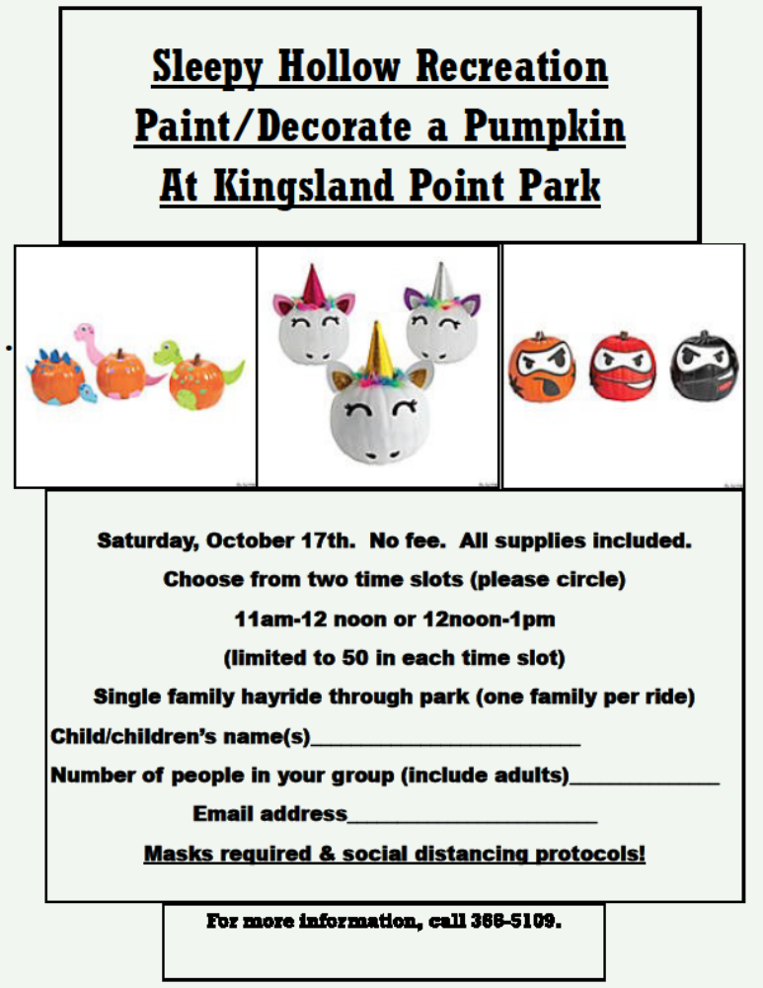
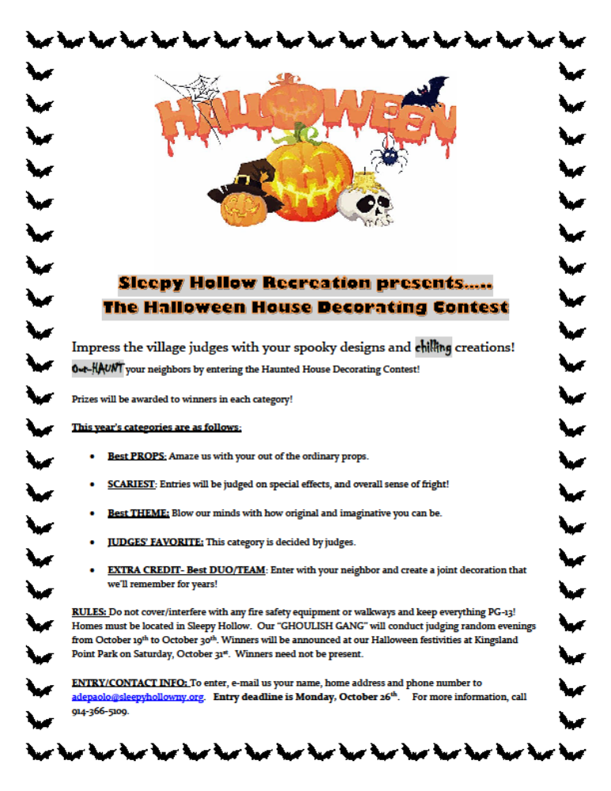
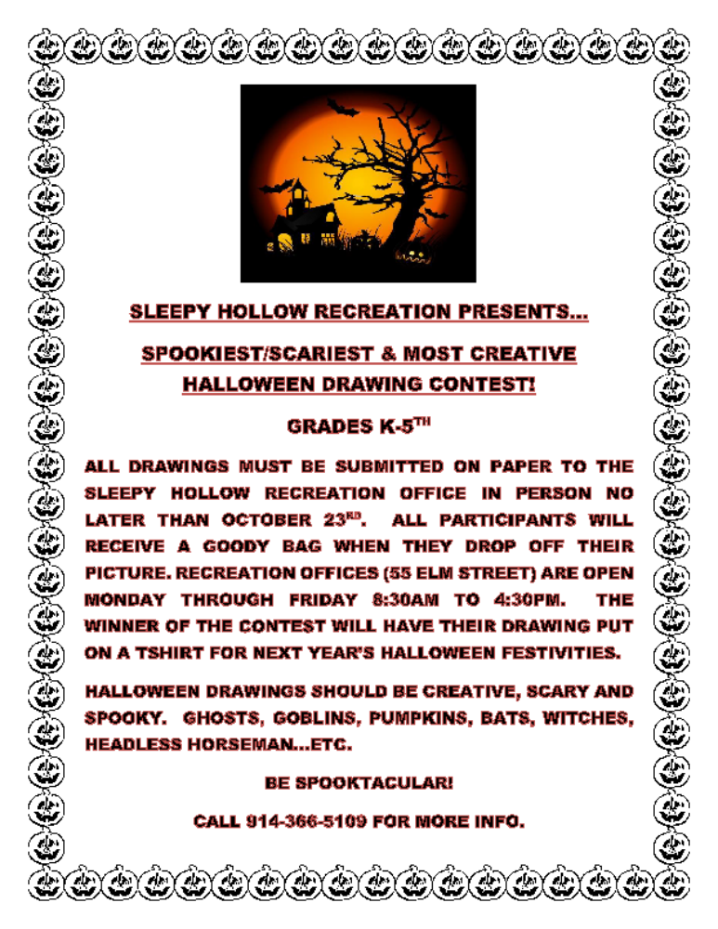

Slide 17
Yorktown
How are modifying these events to make them socially distant and/or compliant with CDC/DOH requirements?
Halloween/Fall Events
December Holiday Events
What have you done in the past?
  Halloween Parade
What are you doing now?
  Drive through Trunk or Treat
  Drive-In movie (Hocus Pocus)
What have you done in the past?
  Electric Lights Parade
What are you doing now?
  Electric Lights Parade (or digital version)
Possible Digital

Slide 18
White Plains
How are modifying these events to make them socially distant and/or compliant with CDC/DOH requirements?
Halloween/Fall Events
December Holiday Events
What have you done in the past?
  Tree Lighting
What are you doing now?
  3 Drive-in Movie nights with DJ, candy bags, magic show, and costumes
What have you done in the past?
  Tree Lighting
  New Year’s Eve event
What are you doing now?
  Drive-in Movie Nights
Reservations required

Slide 19
Westchester County
How are modifying these events to make them socially distant and/or compliant with CDC/DOH requirements?
Halloween/Fall Events
December Holiday Events
What have you done in the past?
  Outdoor Volleyball Tournament
  Charity Walks
What are you doing now?
  2 Halloween themed Drive-in movies
What have you done in the past?
  Winter Wonderland
  Walk Through Light Show
What are you doing now?
  Drive through Light Show
Events in vehicle
Masks and social distancing

Slide 20
